Slide 1


Slide 2


agenda
project progress
new budget system for shop
clusters
overall performance
integrated marketing plan SS 2017 and FW 2017
fall 2017 collection
project and goals

Slide 3

agenda
project progress
new budget system for shop
clusters
overall performance
integrated marketing plan SS 2017 and FW 2017
fall 2017 collection
project and goals

Slide 4

development plan

Slide 5
development plan
2016
italy
49 new opening
25 relocation / restyling
114 new opening + 25 relocation / restyling
row
65 new opening
2017
italy
acceleration phase: completed
completion of the develpment plan and strengthening phase
acceleration for the key countries
opportunities analysis for the row
development for countries with shared plan
row

Slide 6
towards the omnichannel
each market is different and O bag, according to a consumer centric strategy, costumizes the approach to the clients and markets:
change the in-store communication per shops
insert multimedia materials
update the store concept
simulator in store

Slide 7
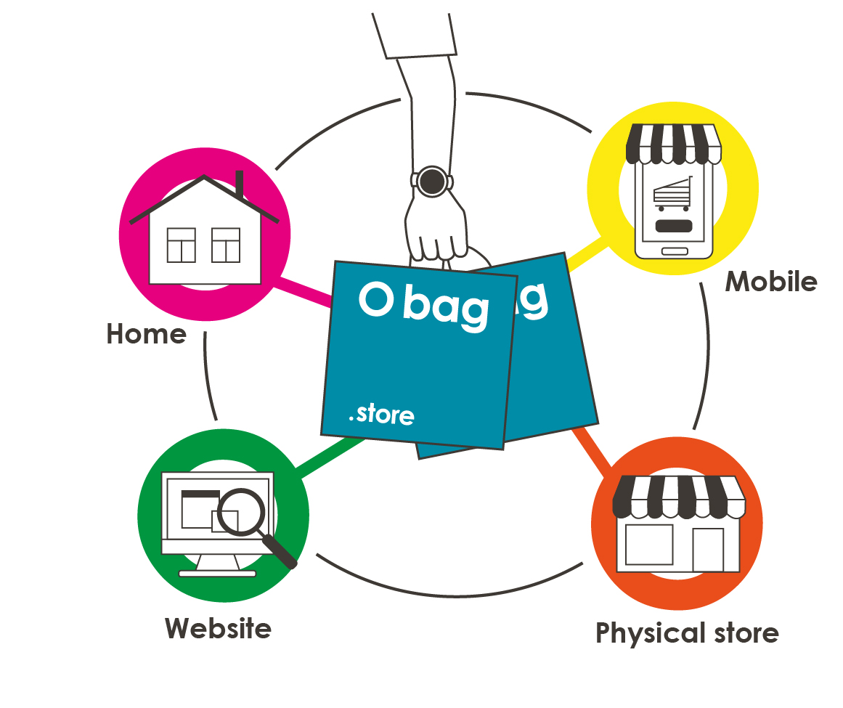
towards the omnichannel
purchase: pc + smartphone + shop
post sales: shop + web
pick up: shop + home

Slide 8
towards the omnichannel
summary
unique and centralize warehouse
service is the key word
company manages the cash flow

Slide 9

simulator

Slide 10
new software
migration software from Zucchetti to Stealth
unique platform
orders – invoicing – integrated warehouse
new ordering system through WEB ORDER
WEB ORDER is connected to our platform and updated to the stock warehouse in real time *traning in the room
new style codes: from sku to item/ size / color
I° quarter of 2017 the business intelligence goes live - Qlik

Slide 11
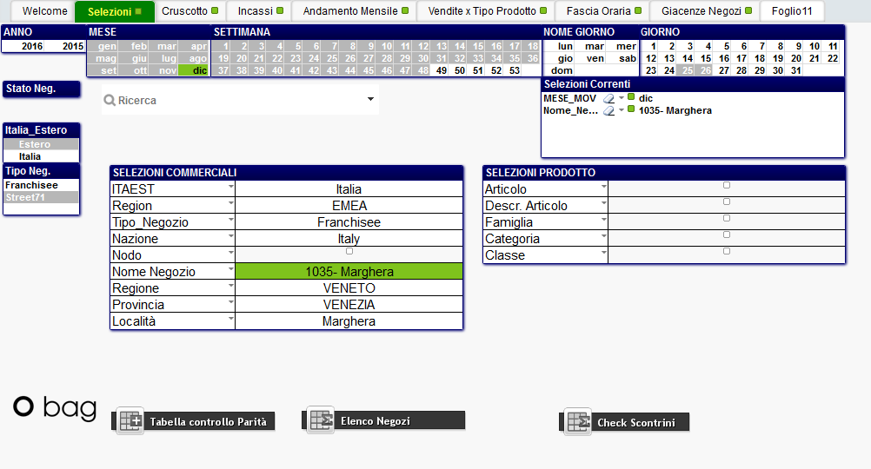
qlik

Slide 12
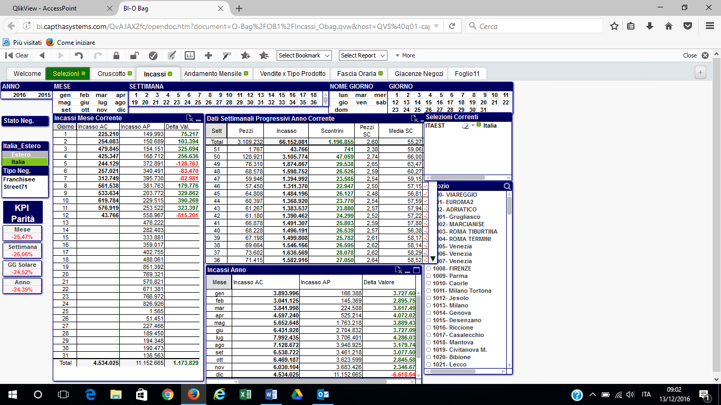
qlik

Slide 13
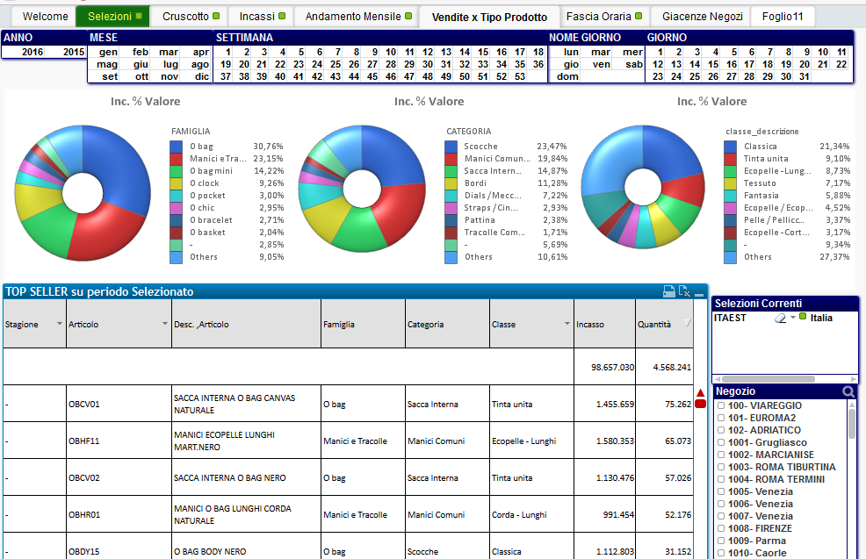
qlik

Slide 14
new commercial calendar
old
new
alignment to the fashion timing
new collection timing accordingly to the countries needs
better delivery planning
the same drop on floor for the multibrand and singlebrand

Slide 15
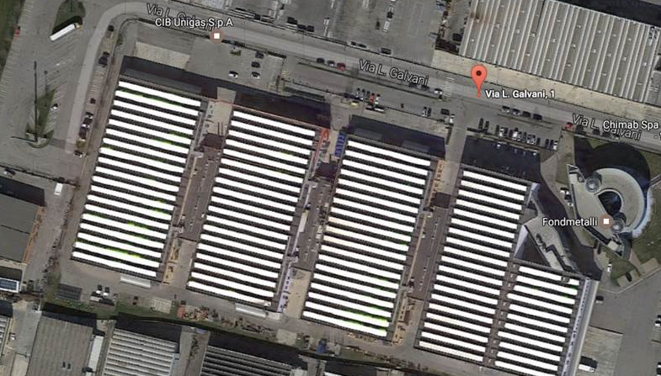
new headquarters
move the office within December 2016
move the logistics department within Summer 2017

Slide 16
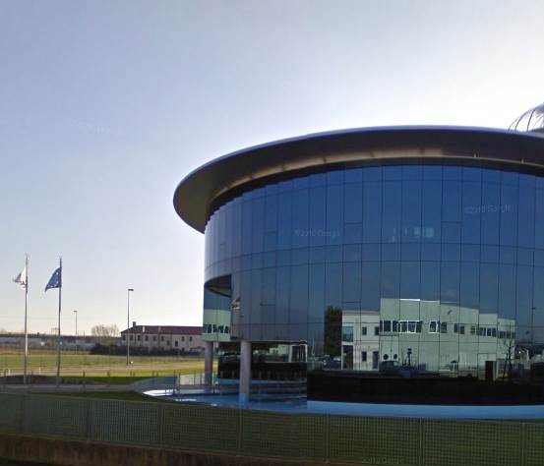
new headquarters
optimization of the actual offices
new capability and capacity of the of the offices and the logistics
new layout
new headquaters consistent with the brand value

Slide 17
agenda
project progress
new budget system for shop
clusters
overall performance
integrated marketing plan SS 2017 and FW 2017
fall 2017 collection
project and goals

Slide 18
new store budget plan
optimizing the sales and reducing the left-over
network mapping
split the shops in within 30 smq / between 30 sqm and 60 sqm / up to 60 sqm
shopping center/ city / seasonal
% of sales for products/ carry over / fashion
guidelines for the purchase of the carry over vs last year
new codes for the carry over items from the 2017
sharing this works for the retail network

Slide 19
cluster: 1° step
cluster S
city
cluster M
cluster L
cluster S
shopping center
cluster M
cluster L

Slide 20
cluster: 2° step
other criteria:
split the network in the same geographic area
priority city – standard city
shopping center premium and standard
turnover

Slide 21
analysis sales fw 2016
select the carry over fw 2017
analyzing the fw ‘16 sales with new carry over and proposal for the fw ‘17 bdg
NB. in the xstore the sales of fw 2016 could be different for the carry over

Slide 22
criteri di utilizzo
criteria
bdg fw ‘17 sell out approach
shop already existing in the last season
analysis of the products of f/w 2016
proposal for the bdg f/w 2017
retail
new opening
product families
analysis of the
relevant cluster
proposal for the f/w 2017
retail/
franchising

Slide 23
new simulator budget

Slide 24
nuovo simulatore budget

Slide 25


franchising network
agent/
clients
company
gives the relevant cluster for shops
create the orders through the cluster incidence

Slide 26
agenda
project progress
new budget system for shop
clusters
overall performance
integrated marketing plan SS 2017 and FW 2017
fall 2017 collection
project and goals

Slide 27
clustering orders
identification of the store type groups per area with similar behaviour: size, carry over / fashion, turnover and channel
proposal of several format of orders
ensure different assortment with same visual and emotional effect
the cluster contains a complete order for each product groups
the client should load the integration in order to reach the bdg divided for data

Slide 28
cluster start up
format large and small for the fall stories
1° theme Folk Naif: in store from 10/08/2017
2° theme Vintage Vantage: in store from 31/08/2017
3° theme Retro-spective: in store from 21/09/2017
increase quantities to reach the bdg with the cluster choice
add the carry over until to reach the bdg

Slide 29
cluster start up
focus
the delivery timing has to be aligned to the in-store planning (1 week before the drop on floor)
the small order contains the window project
the cluster per product group according to visual guideline
no timing for the reorders

Slide 30
agenda
project progress
new budget system for shop
clusters
overall performance
integrated marketing plan SS 2017 and FW 2017
fall 2017 collection
project and goals

Slide 31
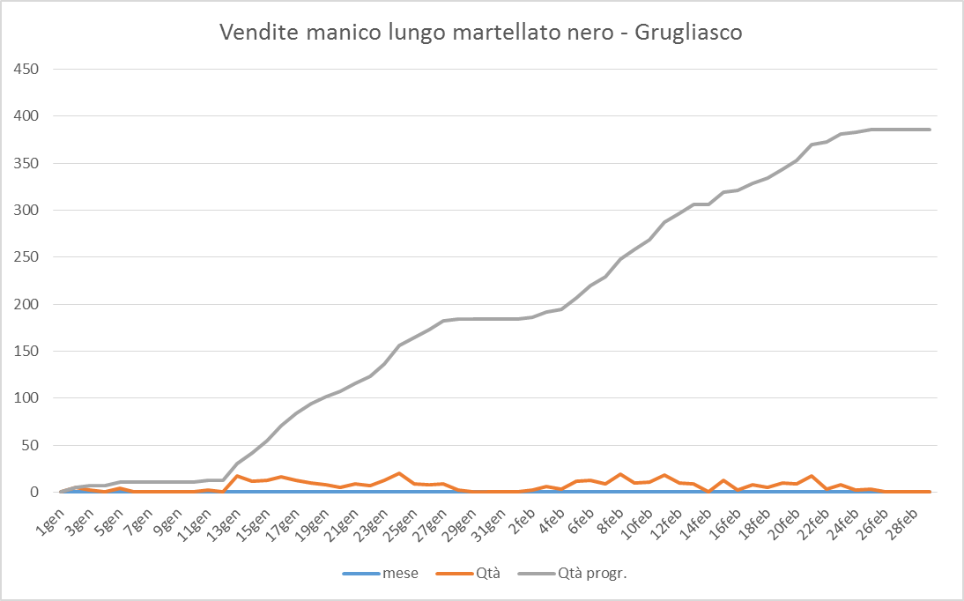
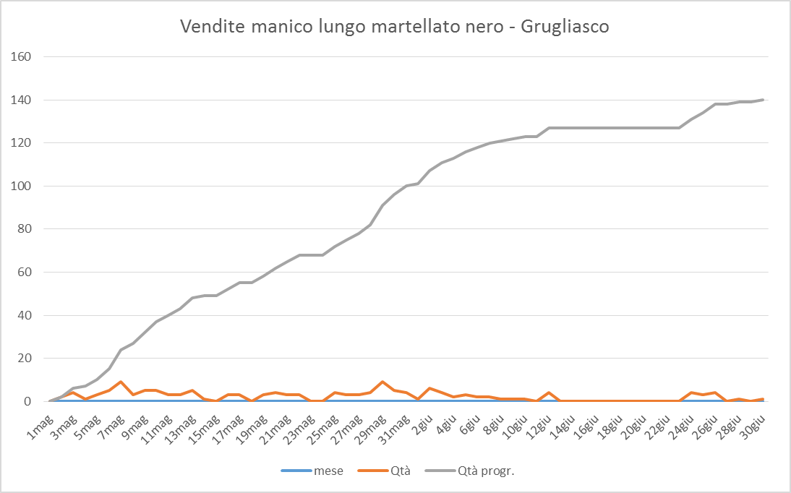
overall performance
I SEM: 18 week – 5 week stock out – 161 handles do not sold because out of the stock
I week
II weeks
I week
I week

Slide 32
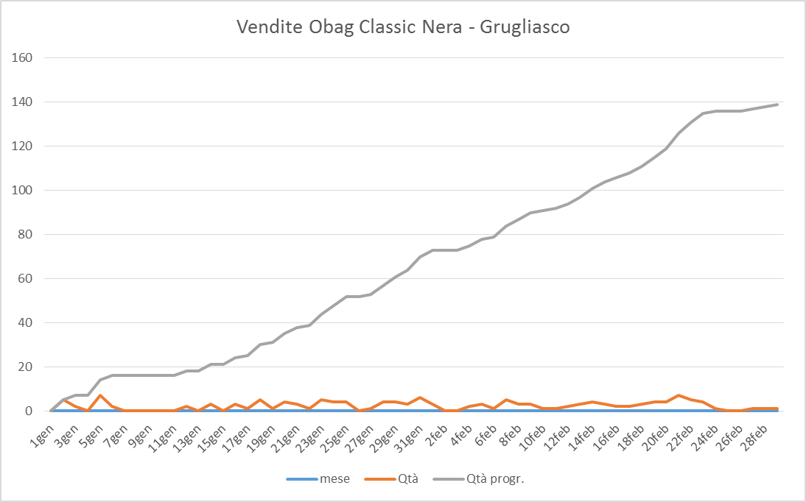
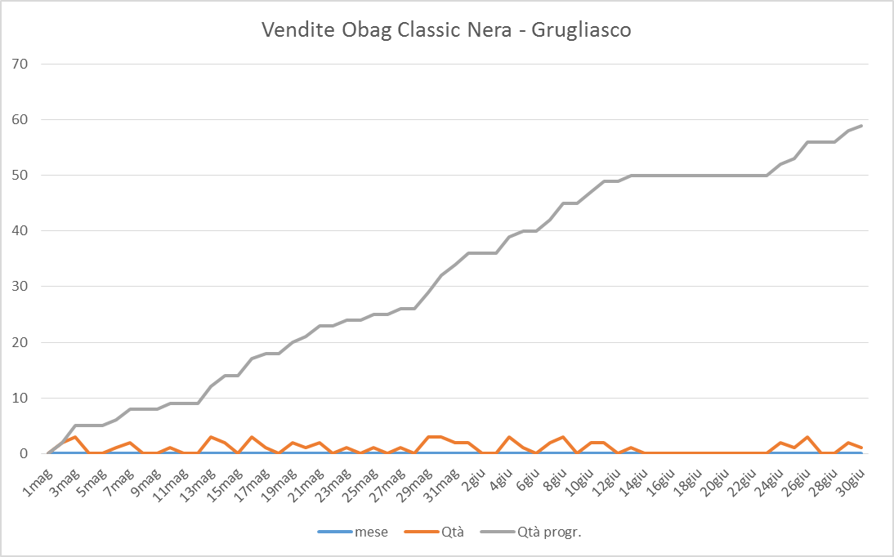
overall performance
I SEM: 18 week – 3 week stock out – 26 bodies do not sold because out of the stock
II weeks
I week

Slide 33
average price analysis
analysis of the average price - fw 2016 vs fw 2015
purchase trend to the lowest price
join the fur free policy from fw ‘16
increase the selling of the accessories with average price lowest

Slide 34
analysis like for like
consideration
pay attention to the average price of the proposal
best sellers (stock unsold)
quality of the order
quality of the visual
training store staff

Slide 35
agenda
project progress
new budget system for shop
clusters
overall performance
integrated marketing plan SS 2017 and FW 2017
fall 2017 collection
project and goals

Slide 36
integrated marketing plan ss 2017

Slide 37
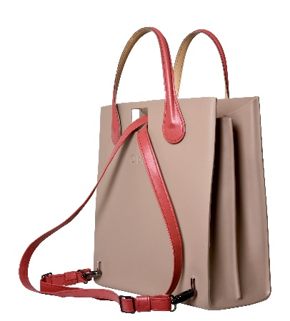
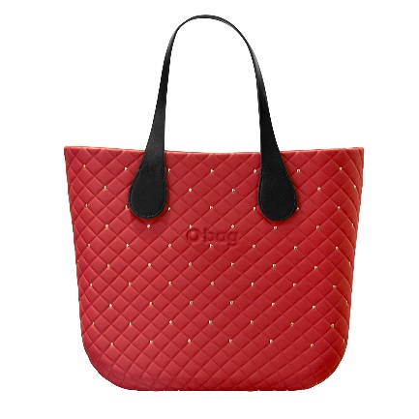
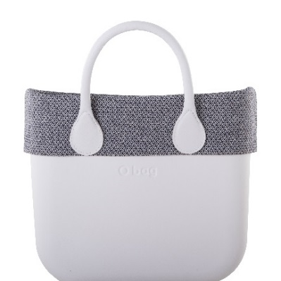
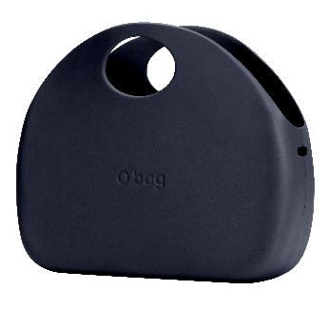
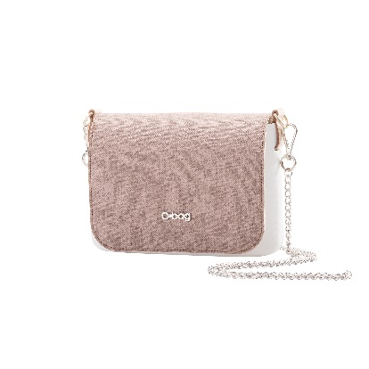
windows calendar spring 2017
12 JAN – 1 FEB
2 FEB –15 FEB
16 FEB – 8 MAR
9 MAR – 29 MAR
30 MAR – 19 APR
TRANSITION
VALENTINE’S
DAY
STORY SPRING
CRUISE
CODE
CAPSULE
O BAG MOON
STORY SPRING
LYRICAL NATURE

Slide 38
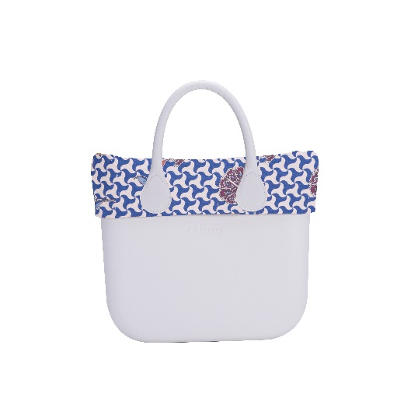
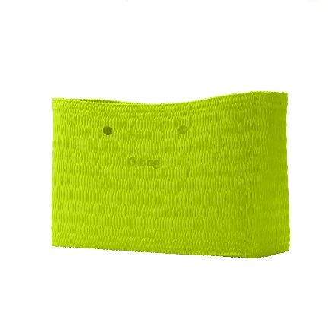
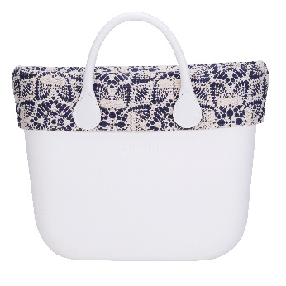
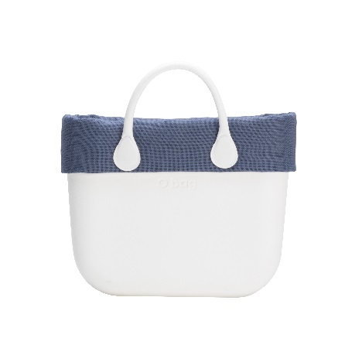
windows calender summer 2017
20 APR – 10 MAY
11 MAY – 31 MAY
1 JUN – 28 JUN
29 JUN – 19 JUL
STORY SUMMER
SAINT-TROPEZ
STORY SUMMER
EAST INDIES
BEACH
COLLECTION
BEACH
COLLECTION

Slide 39
in-store planning ss 2017

Slide 40
integrated marketing plan fw 2017

Slide 41
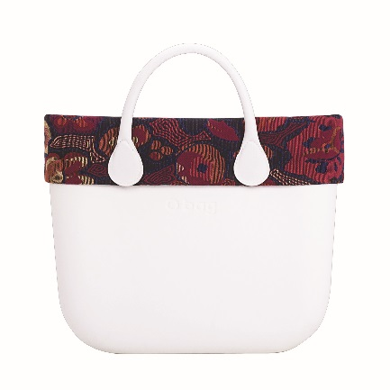
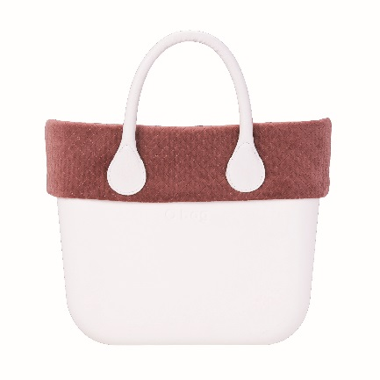
windows calendar fall 2017
20 JUL – 9 AUG
10 AUG – 30 AUG
31 AUG – 20 SEPT
21 SEPT – 11 OCT
TRANSITION
STORY FALL
FOLK
NAIF
STORY FALL
VINTAGE VANTAGE
CAPSULE

Slide 42
windows calendar winter 2017
12 OCT – 25 OCT
26 OCT –15 NOV
16 NOV– 6 DEC
7 DEC– 10 JAN
STORY WINTER
STORY WINTER
FLASH
XMAS 1
FLASH
XMAS 2

Slide 43
in-store planning fw 2017

Slide 44
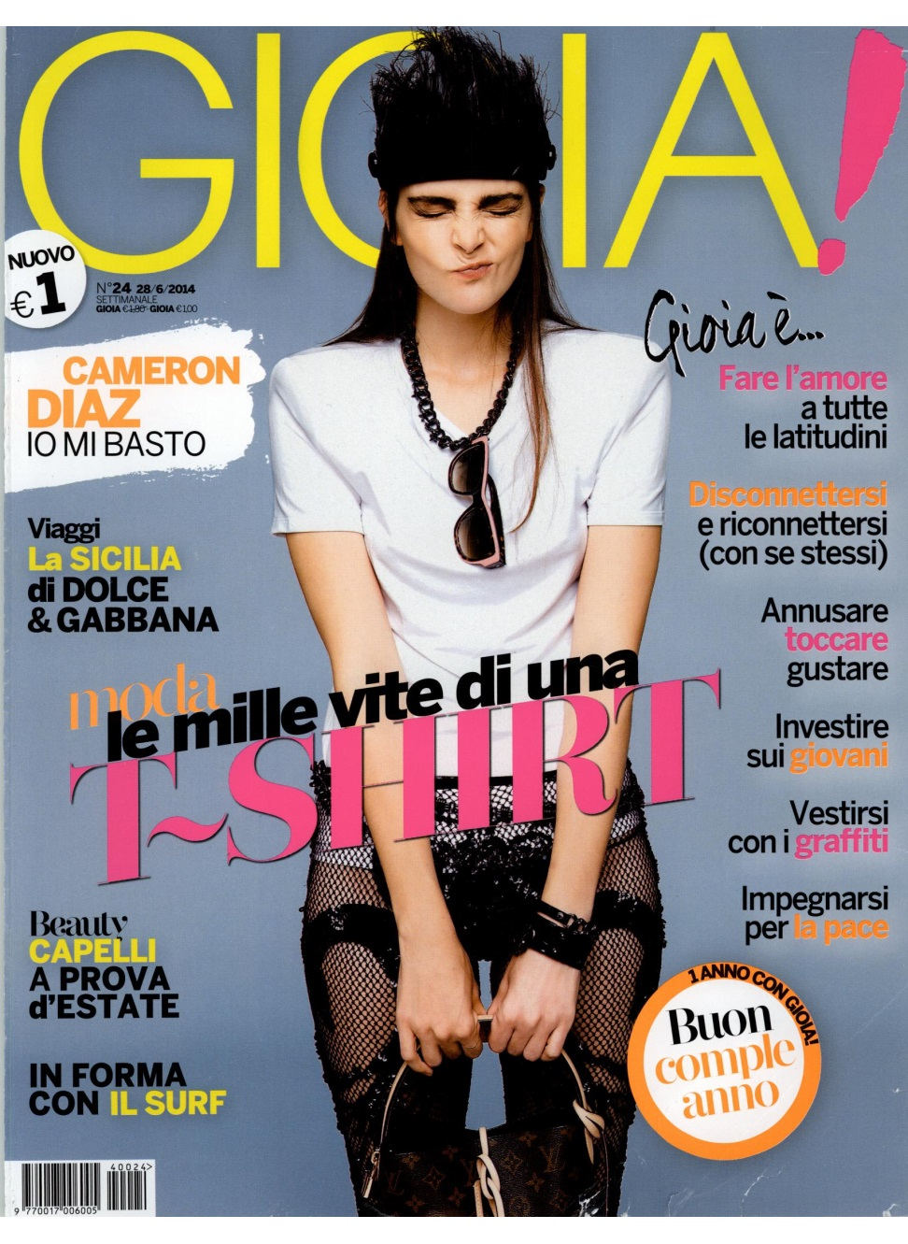
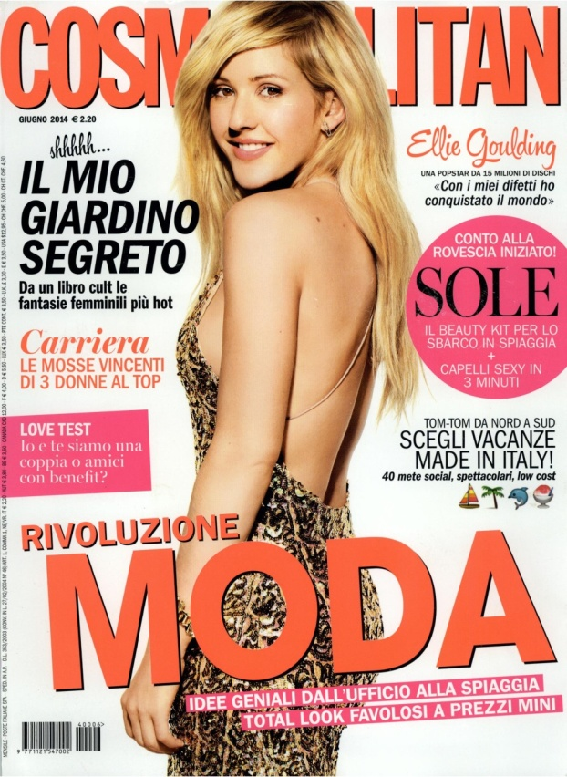
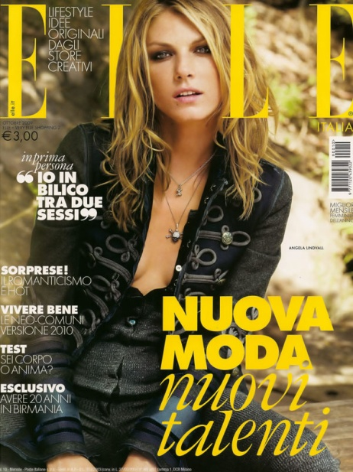
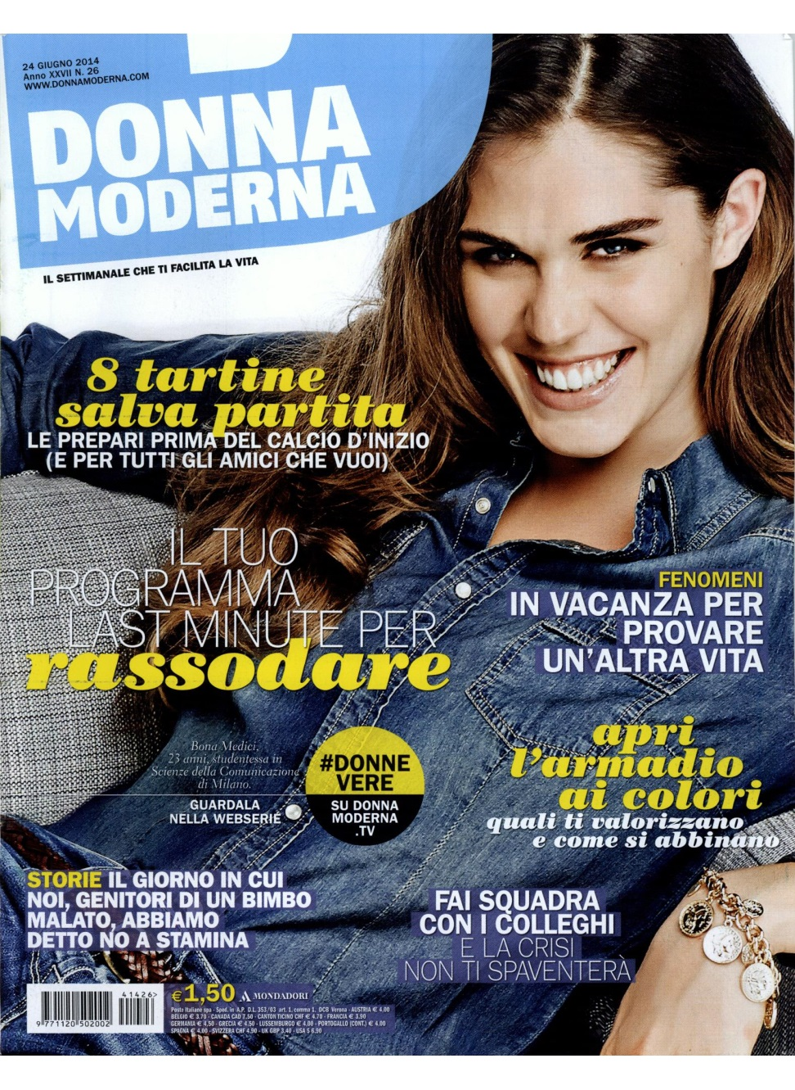
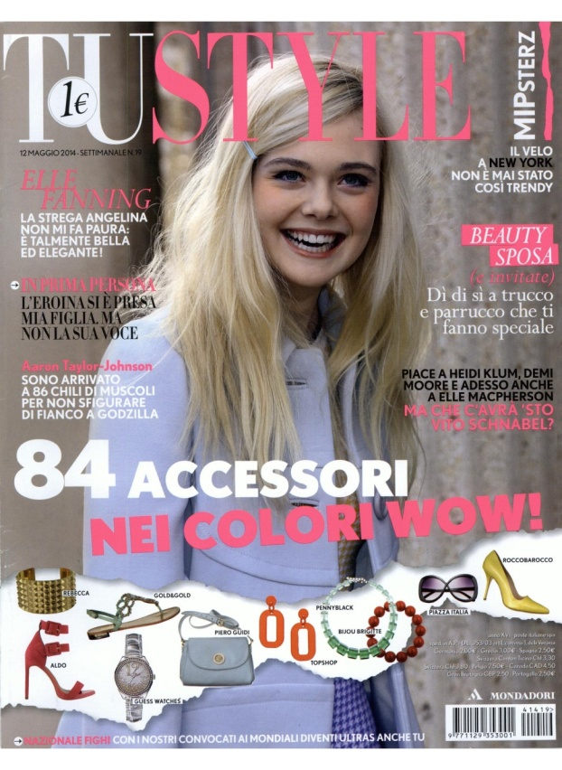

press release – focus italy 2 sem 2016
2016
numbers from Jan
225 editorial for press
213 editorial for web.
30 volte su F (diffusione media 131.920 copie)
11 volte su Elle (dif. 137.741)
11 volte su Gioia (dif. 142.938)
11 volte su Glamour (dif. 154.368)
10 volte su Grazia (dif. 162.608)
7 volte su Amica (dif. 115.408)
6 volte su Cosmopolitan (dif. 132.934)
*dati di diffusione media Italia ed estero certificata ADS.

Slide 45
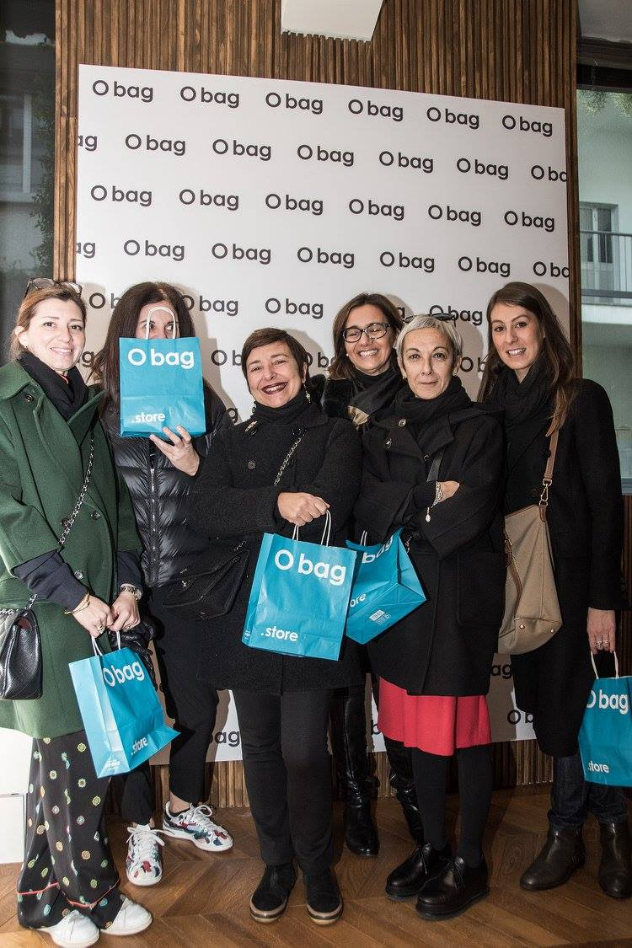
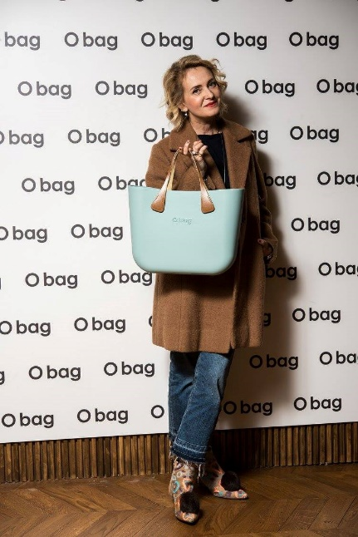
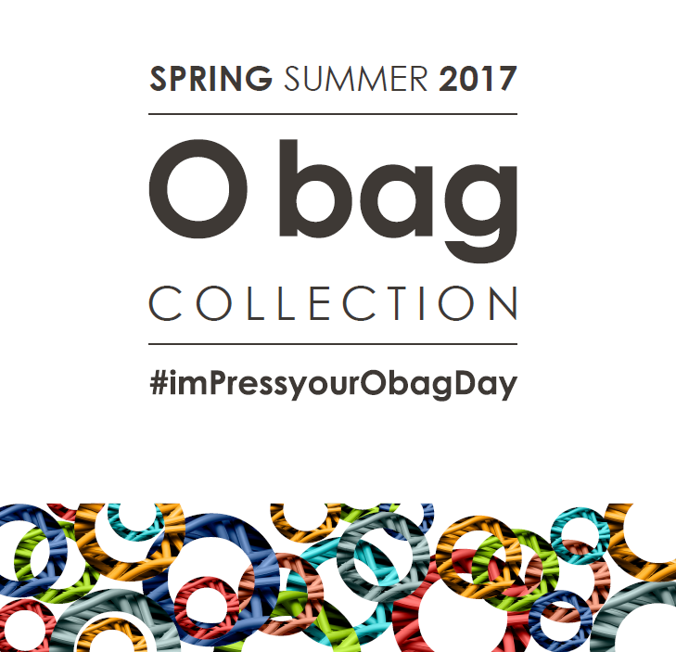
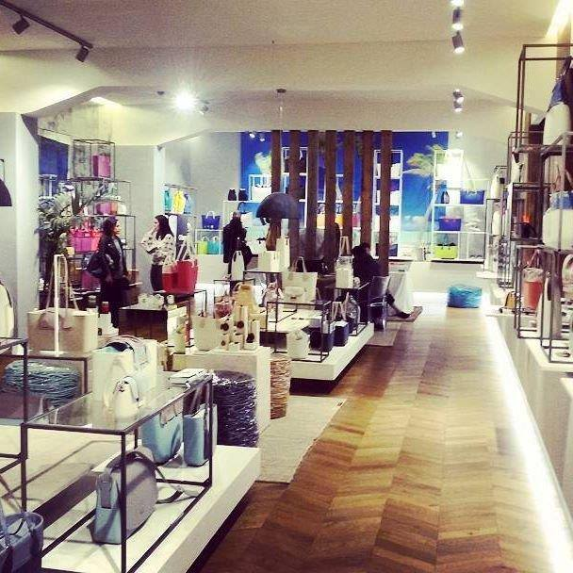
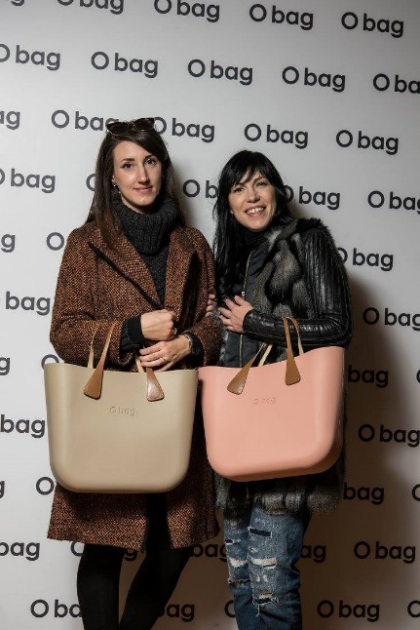
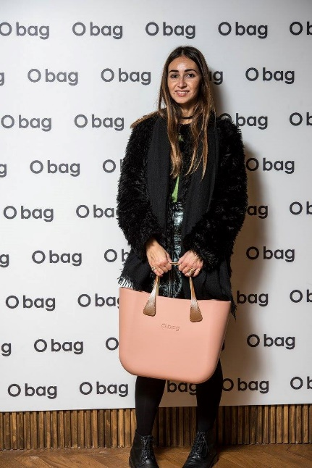
press day SS 2017 – Milano

Slide 46
agenda
project progress
new budget system for shop
clusters
overall performance
integrated marketing plan SS 2017 and FW 2017
fall 2017 collection
project and goals

Slide 47


Slide 48

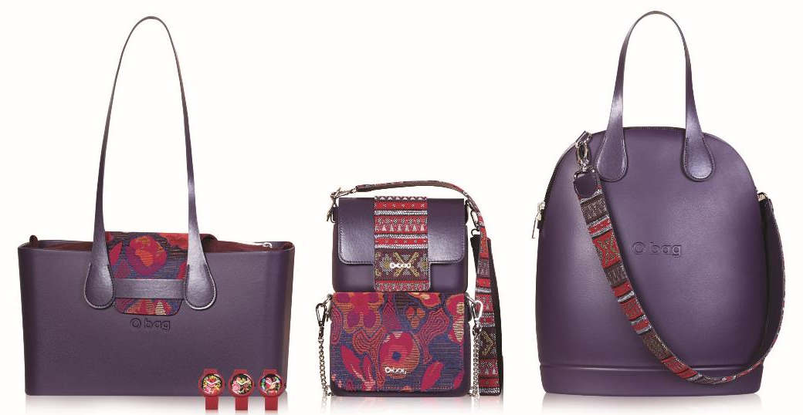
collezione
FOLK NAIF
Neohippy inspiration, folk spirit, ethno vibes.
Handcrafted trend and boho style inspired the first theme of the season.
Floral embroidery and ethnic motif with a folk touch.
Keyword: adventure, that can be find in floral inlay works and tribal motifs inspired by Morocco, the traditional Navajo and by Aztec fabrics.
The fabrics that feature the theme are the unrefined wool, the colorful pois, the flannel melange and bouclé inserts and the multicolor eco fur trims.
The color palette is characterized on intense colours such as teal, bordeaux and aubergine for a colour explosion!
CATEGORIES
HANDLES
O bag: bordo, sacca interna
O bag mini: bordo, sacca interna con zip e con coulisse
O pocket: pattina classica e a fascia
O city: sacca interna
O folder mini: pattina
COLOURS
Micro manico lungo a goccia fantasia fiori; doppia tracollina per O bag moon; tracollina O pocket, tracolla per O folder mini, NUOVA tracolla a goccia forata
bordeaux
teal
aubergine

Slide 49
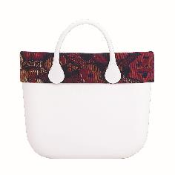
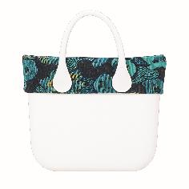
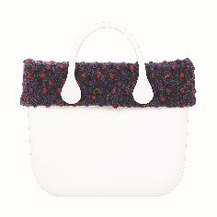
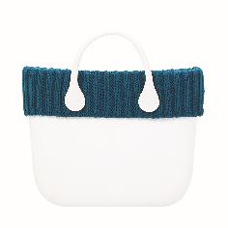
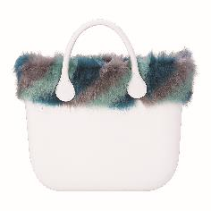
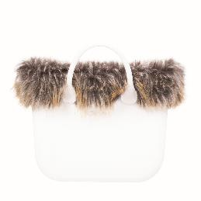

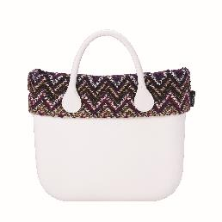
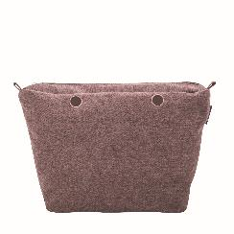
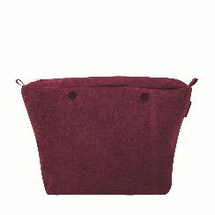
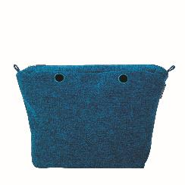
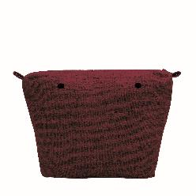
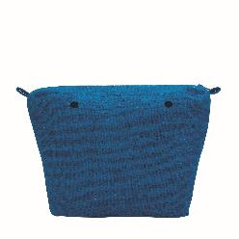
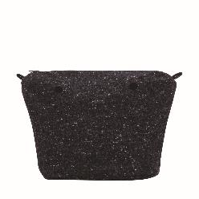
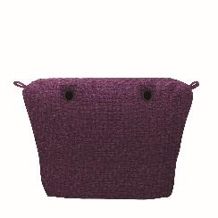
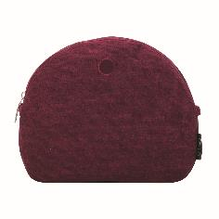
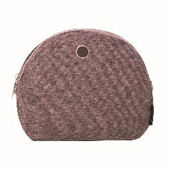
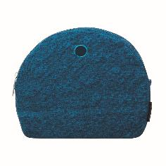



collection – folk naif
O bag
flowers fabric trim
trim with pois
wool trim
eco fur trims
lines fabric trim
flannel melange inserts
unrefined wool inserts
bouclè inserts
O moon
O moon light
flannel inserts

Slide 50
























collection – folk naif
O bag mini
flowers fabric trim
trims with pois
eco fur trims
unrefined wool inserts
flowers fabric inserts with coulisse
flannel melange inserts
O pocket
flowers fabric flaps
flap with pois
tribe fabric flaps
O city
bouclè insert
flowers fabric flaps
insert with pois
flannel melange inserts

Slide 51

















collection – folk naif
O folder mini
cordura inserts
eco leather flaps
handles and shoulder straps
flowers micro handles
shoulder strasp for O bag, O bag mini, O bag ‘50
shoulder straps for O folder mini
shoulder straps O pocket

Slide 52

collection
VINTAGE VANTAGE
Chic vintage style with a romantic touch.
Bon ton effect thanks to delicate and dusty nuances like the phard, the azule blue and grey.
The protagonist is the Velvet, the most noble and shining of all, in all of its forms: Smooth and fluid, embroidered with flowers or matelassè texture.
The elegant and timeless style is also found in the wool accessories.
CATEGORIES
O bag: bordo, chiusura street, sacca interna
O bag mini: bordo, chiusura street, sacca interna con zip
O pocket: pattina classica e a fascia
O city: patta, bordo, sacca interna
O folder mini: pattina
O bag soft: cover
HANDLES
COLOURS
Micro manico con catena, manico lungo extraslim e manico a goccia abbinato a maxi tracolla con dettagli di velluto
blu avio
phard
grey

Slide 53
























collection – vintage vantage
O bag
floral velvet trims
matelassè velvet trims
multicolor velvet trim
standed wool trim
eco leather street
eco fur trims
velvet inserts
O pocket
floral velvet flaps
matelassè velvet flaps
multicolor velvet flaps

Slide 54
















collection – vintage vantage
O bag mini
floral velvet trims
check velvet trims
multicolor velvet trim
standed wool trim
eco leather street
velvet inserts
O city
floral velvet inserts
matelassè velvet inserts
eco leather flaps

Slide 55
















collection – vintage vantage
O bag soft
matelassè
O folder mini
multicolor velvet flaps
O shoes
woman
velvet accessories
manici e tracolle
handles with ring + floral velvet shoulder straps
micro handles with chain

Slide 56

collection
RETRO-SPECTIVE
Retro taste for a deluxe style.
Jacquard motifs and maxi checks on boucle and wool, the true protagonist of autumn, with many twists and sophisticated processes.
The optical fantasy, especially black & white version, is propose again for the cold season, inspired by ‘70s.
The colours are matched according to the geometric pattern.
Red and mustard colour are mixed to blue. The optical effect of black&white create innovative graphic patterns.
CATEGORIES
O bag: bordo classico e zippato, sacca interna
O bag mini: bordo, sacca interna con zip e con coulisse
O pocket: pattina classica
O city: patta, sacca interna
O folder mini: pattina
O bag soft: cover
COLOURS
HANDLES
Micro manico lungo a goccia fantasia optical, manico a goccia abbinato a maxi tracolla
red
mustard
b&w
light blue

Slide 57

















collection – retro spective
O bag
retrò optical trim
maxi check trim
jaquard trims
maxi stranded trims
maxi bouclè trims with zip
O bag mini
maxi check trims
maxi check insert with coulisse
maxi bouclè inserts with coulisse

Slide 58

















collection – retro spective
O city
maxi bouclè inserts
jaquard flaps
O pocket
maxi check flap
jaquard flaps
retrò optical flap
O bag soft
maxi check
soft maxi bouclè
O folder mini
maxi check flap
jaquard flap

Slide 59



collection – retro spective
accessory
jaquard pochette
handles and shoulder straps
handles with ring + shoulder strap retrò optical
handles with ring +
jaquad shoulder strap

Slide 60














crossing
O clock
folk
madras
fluid
O clock great
racing carbon con datario
racing daytona con datario

Slide 61




tema crossing
O sun
naif

Slide 62







crossing
O shoes
woman
rouche wool accessories
O shoes
woman
accessories pom pom

Slide 63












crossing
O square
cordura inserts
handles e shouldes strap
O square
eco leather handles + shoulder strap
One
wavy fabric

Slide 64

VALENTINE’S DAY
2017

Slide 65

capsule
capsule Valentine’s – limited edition
colours

Slide 66
agenda
project progress
new budget system for shop
clusters
overall performance
integrated marketing plan SS 2017 and FW 2017
fall 2017 collection
project and goals

Slide 67

objectivies
uploading new orders within the 30th of January
next presentation Winter 2017 will be the 8th of February
objectivies for the 2017 and development plan situation
support the new bdg process
quality of the orders

Slide 68
.grazie

